Slide 1
Lab QUEUES
CSC-221
Engr. Ayesha
Data Structure and Algorithms

Slide 2

REAL WORLD QUEUE

Slide 3
QUEUES
Queue is an abstract data structure, somewhat similar to Stacks. Unlike stacks, a queue is open at both its ends.
One end is always used to insert data (enqueue) and the other is used to remove data (dequeue).
Queue follows First-In-First-Out methodology, i.e., the data item stored first will be accessed first.

Slide 4
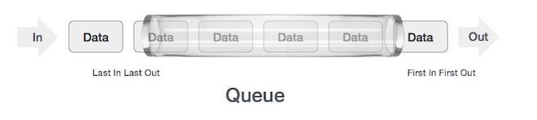
Queue Representation

Slide 5
Queues Implementation
As in stacks, a queue can also be implemented using Arrays, Linked-lists, Pointers and Structures. For the sake of simplicity, we shall implement queues using one-dimensional array.

Slide 6
Basic Operations
Few more functions are required to make the above-mentioned queue operation efficient. These are −
peek() − Gets the element at the front of the queue without removing it.
isfull() − Checks if the queue is full.
isempty() − Checks if the queue is empty.

Slide 7
Basic Operations
Queue operations may involve initializing or defining the queue, utilizing it, and then completely erasing it from the memory. Here we shall try to understand the basic operations associated with queues −
enqueue() − add (store) an item to the queue.
dequeue() − remove (access) an item from the queue.

Slide 8
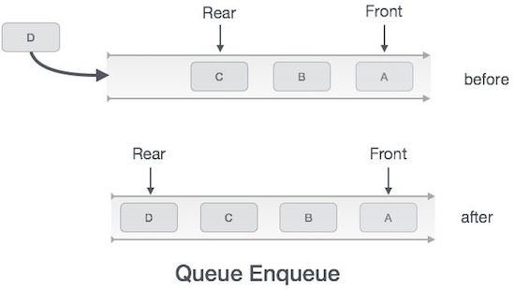
ENQUEUE

Slide 9
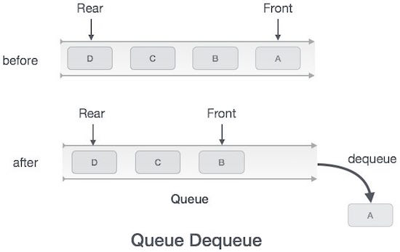
DEQUEUE

Slide 10
Queue
In queue, we always dequeue (or access) data, pointed by front pointer and while enqueing (or storing) data in the queue we take help of rear pointer.

Slide 11
Queue Operations
int A[10]
front=-1
rear=-1
Bool IsEmpty(front,rear)
{
if (front==-1 && rear==-1)
return true
else
return false
}
Bool IsFull(array,rear)
{
If rear==size(A)-1
Print “ queue is full”
Return
}

Slide 12
ENQUEUE AND DEQUEUE
Enqueue(x)
{
If IsFull()
Return
Else if IsEmpty()
{
front=0
rear=0
A[rear]=x
}
else
{
rear=rear+1
A[rear]=x
}
Dequeue()
{
If IsEmpty()
return
else if (front==rear)
{
Front=rear=-1 }
else
{
front=front+1
}

Slide 13
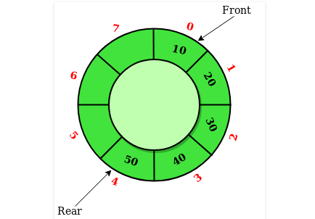
Circular Queues
Circular Queue is a linear data structure in which the operations are performed based on FIFO (First In First Out) principle and the last position is connected back to the first position to make a circle. It is also called ‘Ring Buffer’.

Slide 14
QUEUES VS CIRCULAR QUEUES
In a normal Queue, we can insert elements until queue becomes full. But once queue becomes full, we can not insert the next element even if there is a space in front of queue.

Slide 15
CIRCULAR QUEUE OPERATIONS
IsFull()
{
If (rear+1)%N==front
Print “ queue is full”
Return
}
Enqueue(x)
{
If IsFull()
Return
Else if IsEmpty()
{
front=0
rear=0
A[rear]=x
}
else
{
rear=(rear+1)%N
A[rear]=x
}

Slide 16
CIRCULAR QUEUE OPERATIONS
Dequeue()
{
If IsEmpty()
return
else if (front==rear)
{
Front=rear=-1 }
else
{
front=(front+1)%N
}
Front()
{
(If front==-1)
Return
else
Return A[front]
}

Slide 17
Lab Tasks
Design & implement all methods of Simple Queue.
Design & implement all methods of Circular Queue.
Design and implement for Priority Queue.
Method 1: Ordering in/ after Enqueue method
Method 2: Separate queues for different priorities.

Slide 18
Thanks You

